Slide 1
Modern Programming Languages
UIIT PMAS Arid Agriculture University, Rawalpindi
Course Instructor: Suleman Khurram

Slide 2
Introduction to Arrays
An array is a data structure used to process a collection of data that is all of the same type
An array behaves like a numbered list of variables with a uniform naming mechanism
It has a part that does not change: the name of the array
It has a part that can change: an integer in square brackets
For example, given five scores:
score[0], score[1], score[2], score[3], score[4]

Slide 3
Creating and Accessing Arrays
An array that behaves like this collection of variables, all of type double, can be created using one statement as follows:
double[] score = new double[5];
Or using two statements:
double[] score;
score = new double[5];
The first statement declares the variable score to be of the array type double[]
The second statement creates an array with five numbered variables of type double and makes the variable score a name for the array

Slide 4
Creating and Accessing Arrays
The individual variables that together make up the array are called indexed variables
They can also be called subscripted variables or elements of the array
The number in square brackets is called an index or subscript
In Java, indices must be numbered starting with 0, and nothing else
score[0], score[1], score[2], score[3], score[4]

Slide 5
Creating and Accessing Arrays
The number of indexed variables in an array is called the length or size of the array
When an array is created, the length of the array is given in square brackets after the array type
The indexed variables are then numbered starting with 0, and ending with the integer that is one less than the length of the array
score[0], score[1], score[2], score[3], score[4]

Slide 6
Creating and Accessing Arrays
double[] score = new double[5];
A variable may be used in place of the integer (i.e., in place of the integer 5 above)
The value of this variable can then be read from the keyboard
This enables the size of the array to be determined when the program is run
double[] score = new double[count];
An array can have indexed variables of any type, including any class type
All of the indexed variables in a single array must be of the same type, called the base type of the array

Slide 7
Declaring and Creating an Array
An array is declared and created in almost the same way that objects are declared and created:
BaseType[] ArrayName = new BaseType[size];
The size may be given as an expression that evaluates to a nonnegative integer, for example, an int variable
char[] line = new char[80];
double[] reading = new double[count];

Slide 8
Referring to Arrays and Array Elements
Each array element can be used just like any other single variable by referring to it using an indexed expression: score[0]
The array itself (i.e., the entire collection of indexed variables) can be referred to using the array name (without any square brackets): score
An array index can be computed when a program is run
It may be represented by a variable: score[index]
It may be represented by an expression that evaluates to a suitable integer: score[next + 1]

Slide 9
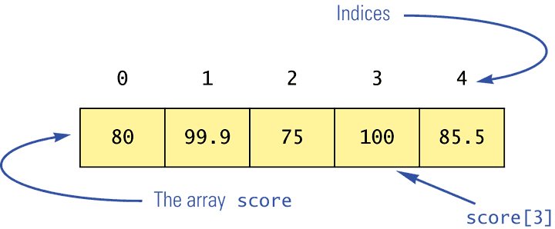
Using the score Array in a Program
The for loop is ideally suited for performing array manipulations:
for (index = 0; index < 5; index++)
System.out.println(score[index] +
" differs from max by " +
(max-score[index]) );

Slide 10
Three Ways to Use Square Brackets [] with an Array Name
Square brackets can be used to create a type name:
double[] score;
Square brackets can be used with an integer value as part of the special syntax Java uses to create a new array:
score = new double[5];
Square brackets can be used to name an indexed variable of an array:
max = score[0];

Slide 11
The length Instance Variable
An array is considered to be an object
Since other objects can have instance variables, so can arrays
Every array has exactly one instance variable named length
When an array is created, the instance variable length is automatically set equal to its size
The value of length cannot be changed (other than by creating an entirely new array with new)
double[] score = new double[5];
Given score above, score.length has a value of 5

Slide 12
Initializing Arrays
An array can be initialized when it is declared
Values for the indexed variables are enclosed in braces, and separated by commas
The array size is automatically set to the number of values in the braces
int[] age = {2, 12, 1};
Given age above, age.length has a value of 3

Slide 13
Initializing Arrays
Another way of initializing an array is by using a for loop
int[] temp= new int[100];
int index;
for (index = 0; index < temp.length; index++)
temp[index] = 10;
If the elements of an array are not initialized explicitly, they will automatically be initialized to the default value for their base type

Slide 14
Arrays and References
Like class types, a variable of an array type holds a reference
Arrays are objects
A variable of an array type holds the address of where the array object is stored in memory
Array types are (usually) considered to be class types

Slide 15
Arrays are Objects
An array can be viewed as a collection of indexed variables
An array can also be viewed as a single item whose value is a collection of values of a base type
An array variable names the array as a single item
double[] a;
A new expression creates an array object and stores the object in memory
new double[10]
An assignment statement places a reference to the memory address of an array object in the array variable
a = new double[10];

Slide 16
Array Parameters
Both array indexed variables and entire arrays can be used as arguments to methods
An indexed variable can be an argument to a method in exactly the same way that any variable of the array base type can be an argument

Slide 17
Array Parameters
double n = 0.0;
double[] a = new double[10];//all elements
//are initialized to 0.0
int i = 3;
Given myMethod which takes one argument of type double, then all of the following are legal:
myMethod(n);//n evaluates to 0.0
myMethod(a[3]);//a[3] evaluates to 0.0
myMethod(a[i]);//i evaluates to 3,
//a[3] evaluates to 0.0

Slide 18
Command-Line Arguments
The signature of the main method indicates that it takes an array of String objects as a parameter
These values come from command-line arguments that are provided when the interpreter is invoked
For example, the following invocation of the interpreter passes an array of three String objects into main:
> java StateEval pennsylvania texas arizona
These strings are stored at indexes 0-2 of the parameter

Slide 19
Arrays of Objects
Objects can have arrays as instance variables
Many useful structures can be created with arrays and objects
The software designer must determine carefully an organization of data and objects that makes sense for the situation.

Slide 20
Sorting an Array
Sorting is an important feature of arrays.
In many application we need to sort arrays either in ascending or descending orders.
Common algorithms for sorting an array are
Selection Sort
Bubble Sort
Although these algorithms are not efficient for sorting an array of large number but can be used for sorting medium or small arrays.

Slide 21
Arrays Class in Java
The Arrays class in java.util package is a part of the Java Collection Framework.
This class provides static methods to dynamically create and access Java arrays.
Static methods means that the methods of this class can be used by the class name itself.
The following slides explains some of the useful methods of Arrays class.

Slide 22
Methods of Arrays Class
Arrays.sort() method is used to sort an array in ascending order (as explained in coming slide)
Syntax of Arrays.sort() is as below… Arrays.sort(arrayName);

Slide 23
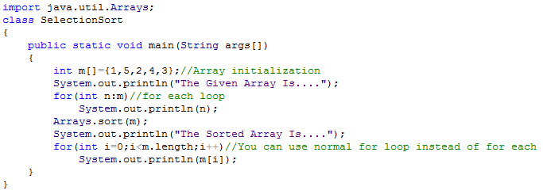
Arrays.sort() Method

Slide 24
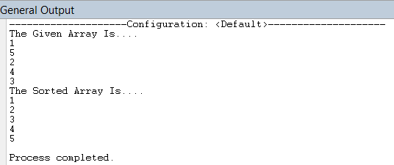
Arrays.sort() Method…
The output of the code given in the last slide

Slide 25
Arrays.binarySearch() Method
Arrays.binarySearch() method is used to search an item in the array.
If the given item is not found in the given array then Arrays.binarySearch() method returns -1.
If the given item is found in the given array then Arrays.binarySearch() method returns 0 or a positive value
Array must be sorted before using Arrays.binarySearch() methd

Slide 26
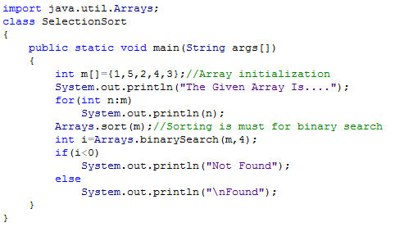
Arrays.binarySearch() Method…

Slide 27
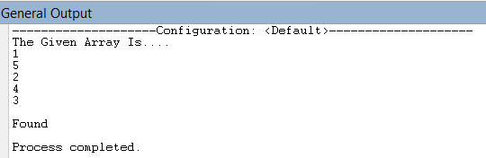
Arrays.binarySearch() Method…

Slide 28
Arrays.copyOf() Method
Arrays.copyOf() method copies contents of one array to another.
Arrays.copyOf() accepts an array as the first argument and an integer as the second arguments.
The second integer arguments specifies that how many values should be copied to the resultant array.

Slide 29
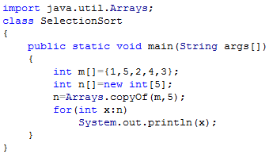
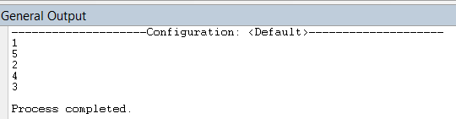
Arrays.copyOf() Method…

Slide 30
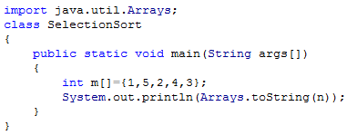

Arrays.toString() Method
Arrays.toString() is used to display the contents of an array.

Slide 31
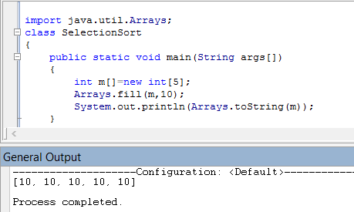
Arrays.fill() Method…
Arrays.fill() method is used to fill an array with a specified value.

Slide 32
Multidimensional Arrays
It is sometimes useful to have an array with more than one index
Multidimensional arrays are declared and created in basically the same way as one-dimensional arrays
You simply use as many square brackets as there are indices
Each index must be enclosed in its own brackets
double[][]table = new double[100][10];
int[][][] figure = new int[10][20][30];

Slide 33
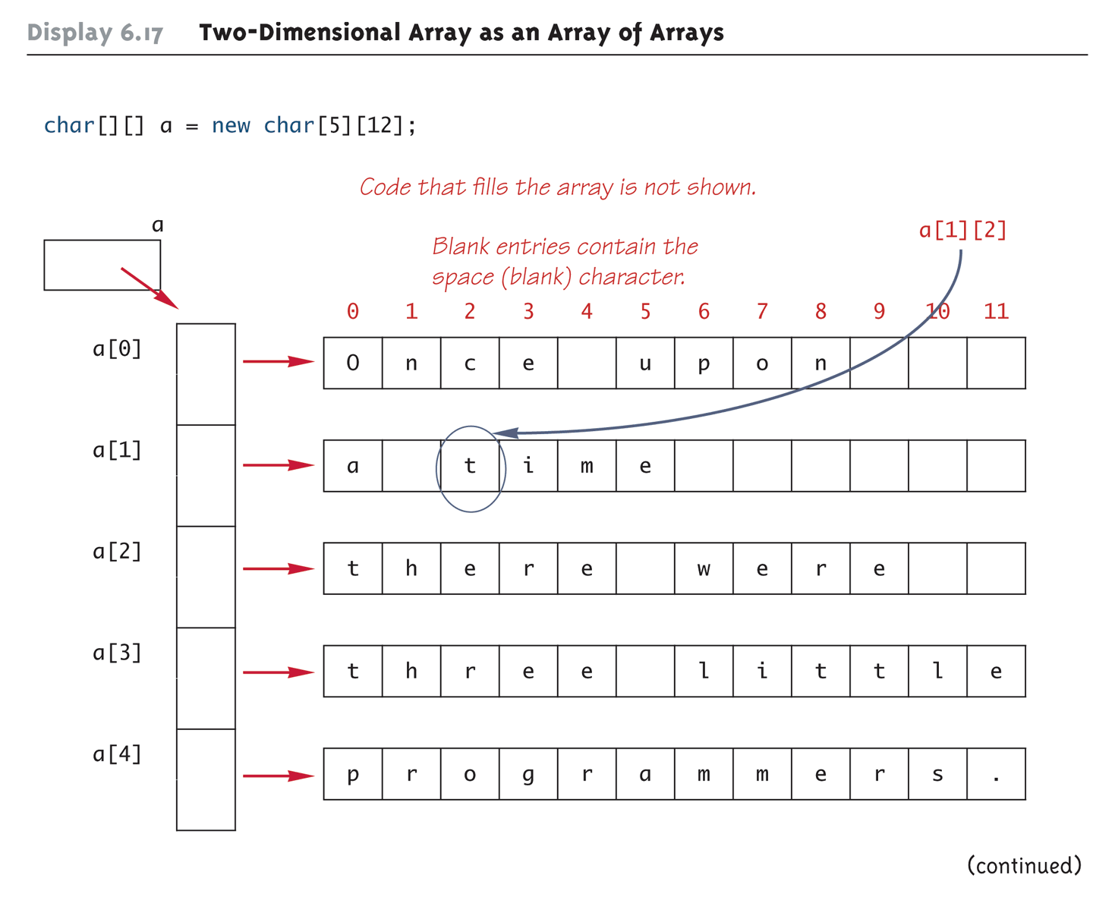
Two-Dimensional Array as an Array of Arrays (Part 1 of 2)

Slide 34
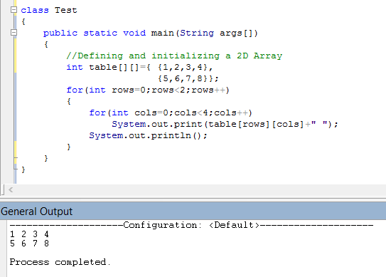
2D Array Example

Slide 35
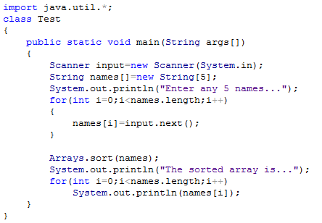
String Arrays

Slide 36
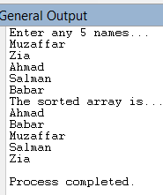

Slide 37
The ArrayList Class
Although arrays are conceptually important as a data structure, they are not used as much in Java as they are in most other languages. The reason is that the java.util package includes a class called ArrayList that provides the standard array behavior along with other useful operations.
ArrayList is a Java class rather than a special form in the language. As a result, all operations on ArrayLists are indicated using method calls. For example,
You create a new ArrayList by calling the ArrayList constructor.
You get the number of elements by calling the size method rather than by selecting a length field.
You use the get and set methods to select individual elements.

Slide 38
Methods in the ArrayList class
Figure 11-12, p. 443, where <T> is the base type.
boolean add(<T> element)
<T> remove(int index)
int indexOf(<T> value)
An ArrayList allows you to add new elements to the end of a list. By contrast, you can’t change the size of an existing array without allocating a new array and then copying all the elements from the old array into the new one.

